Slide 1
Voltage, Current, Resistance

Slide 2
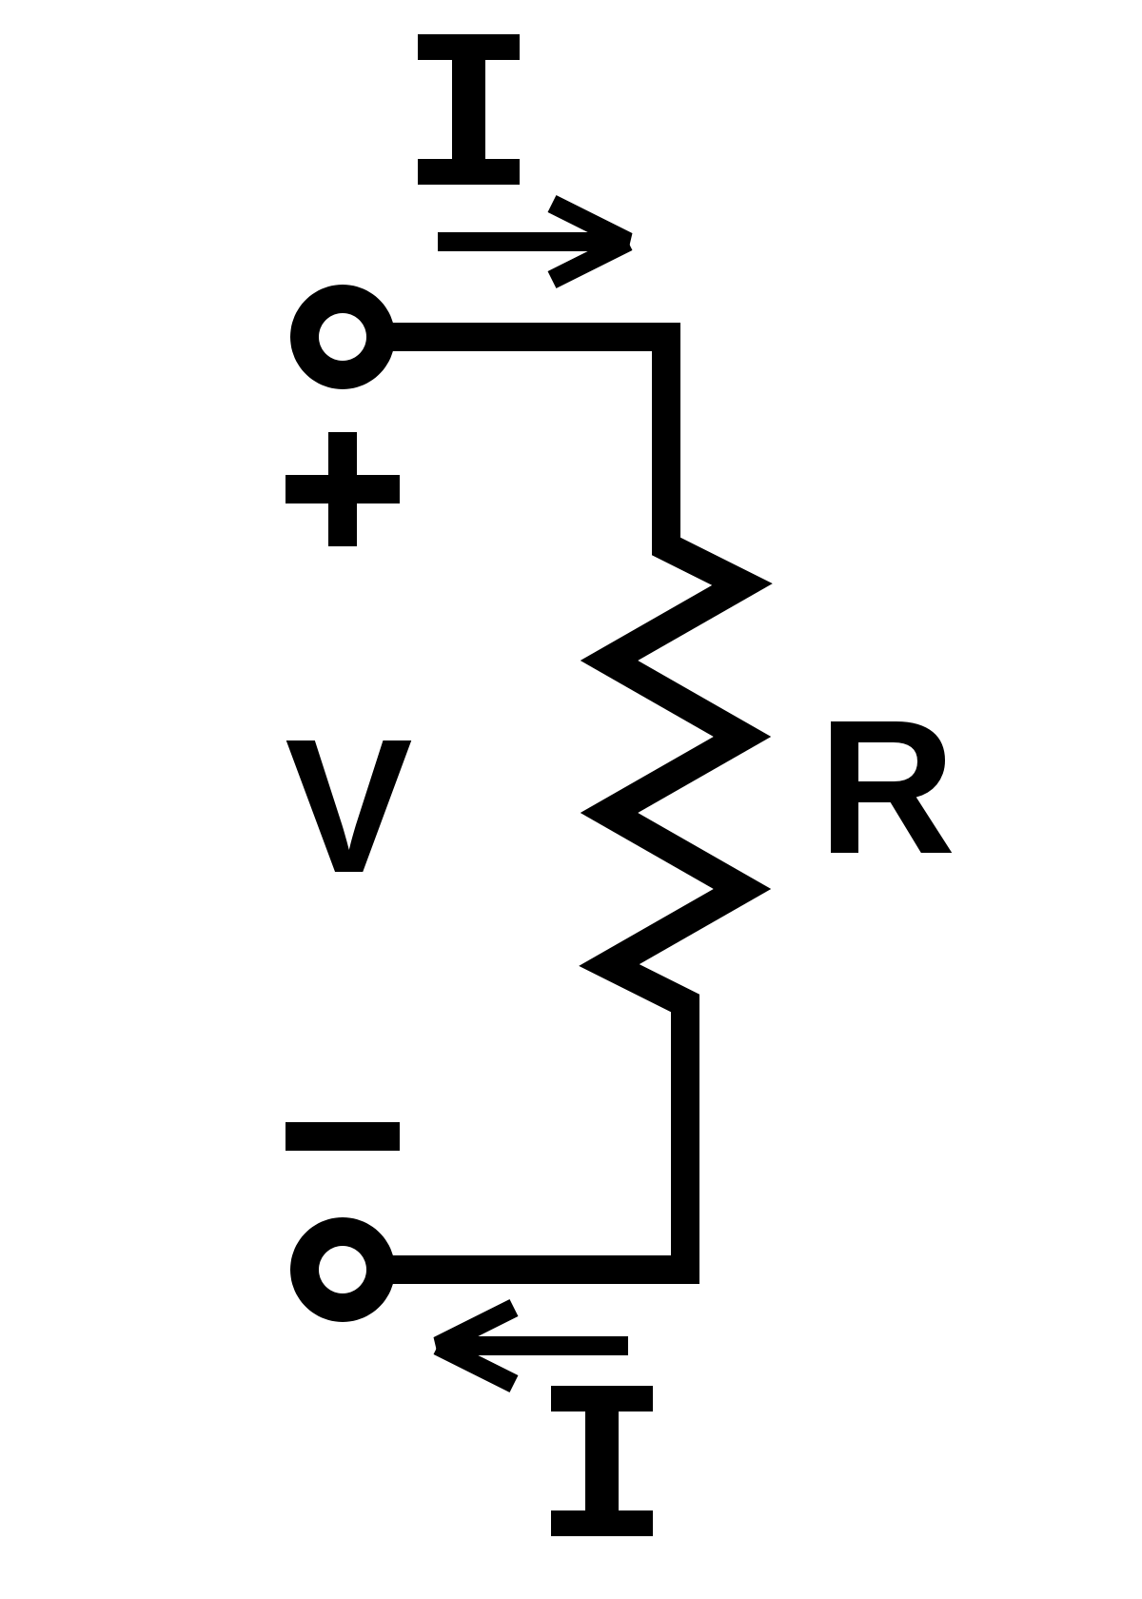
Ohm’s Law
Voltage = current*resitance
V = IR
I = V/R = 12volts/0 ohms = infinity amps
Resistance can also be work done
Resistance in the wires will generate heat
What happens if there is an electrical short?

Slide 3
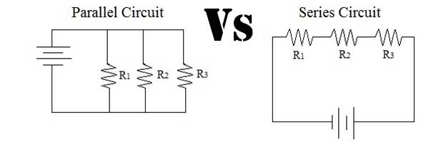
Series and Parallel Circuits
0V
4V
8V
12V
12V
9 A
12V
12V
12V
0V
2 A
2 A
5 A
0V
9 A
0V
12V

Slide 4
Analog and Digital Signals

Slide 5
PWM Signal
Pulse Width Modulation
Value is related to the amount of time at 5v
vs the amount of time at 0V

Slide 6
CAN Bus
Controller Area Network

Slide 7
Brushed Motors

Slide 8
Brushless Motors
https://www.youtube.com/watch?v=bCEiOnuODac

